Slide 1
Electricity Billing Database Management System
202118023 - Pratik Patil
202118028 - Bhavya Chandrasala
202118031 - Jeffrey James
202118039 - Tanya Jagyasi

Slide 2
INDEX
Page No
Description
Problem Statement
Entity Relationship Diagram
Schema Diagram
SQL DDL Model
SQL DML Model
Functional Requirements
Conclusion and learning
03
04
05
06
07
08
09
15

Slide 3
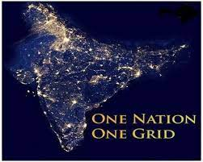

Description
The National Grid is the high-voltage electricity transmission network in India,
connecting power stations and major substations, ensuring that electricity generated
anywhere in India can be used to satisfy demand elsewhere.
Electric supply is done all over the country as electricity is a basic need for today’s
world. As a result, even in cities, a huge amount of data is generated by households
that consume electricity for their daily needs.

Slide 4
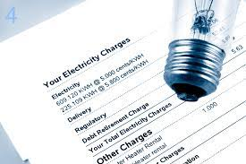
Problem Statement
Now a days people find it very difficult to keep the records of their electric bill payments. This system will help them to keep track of their payments.
Problems like:-
Record of Payments
Maintenance of Meters
To keep the tracks of employee
Invoice generation

Slide 5
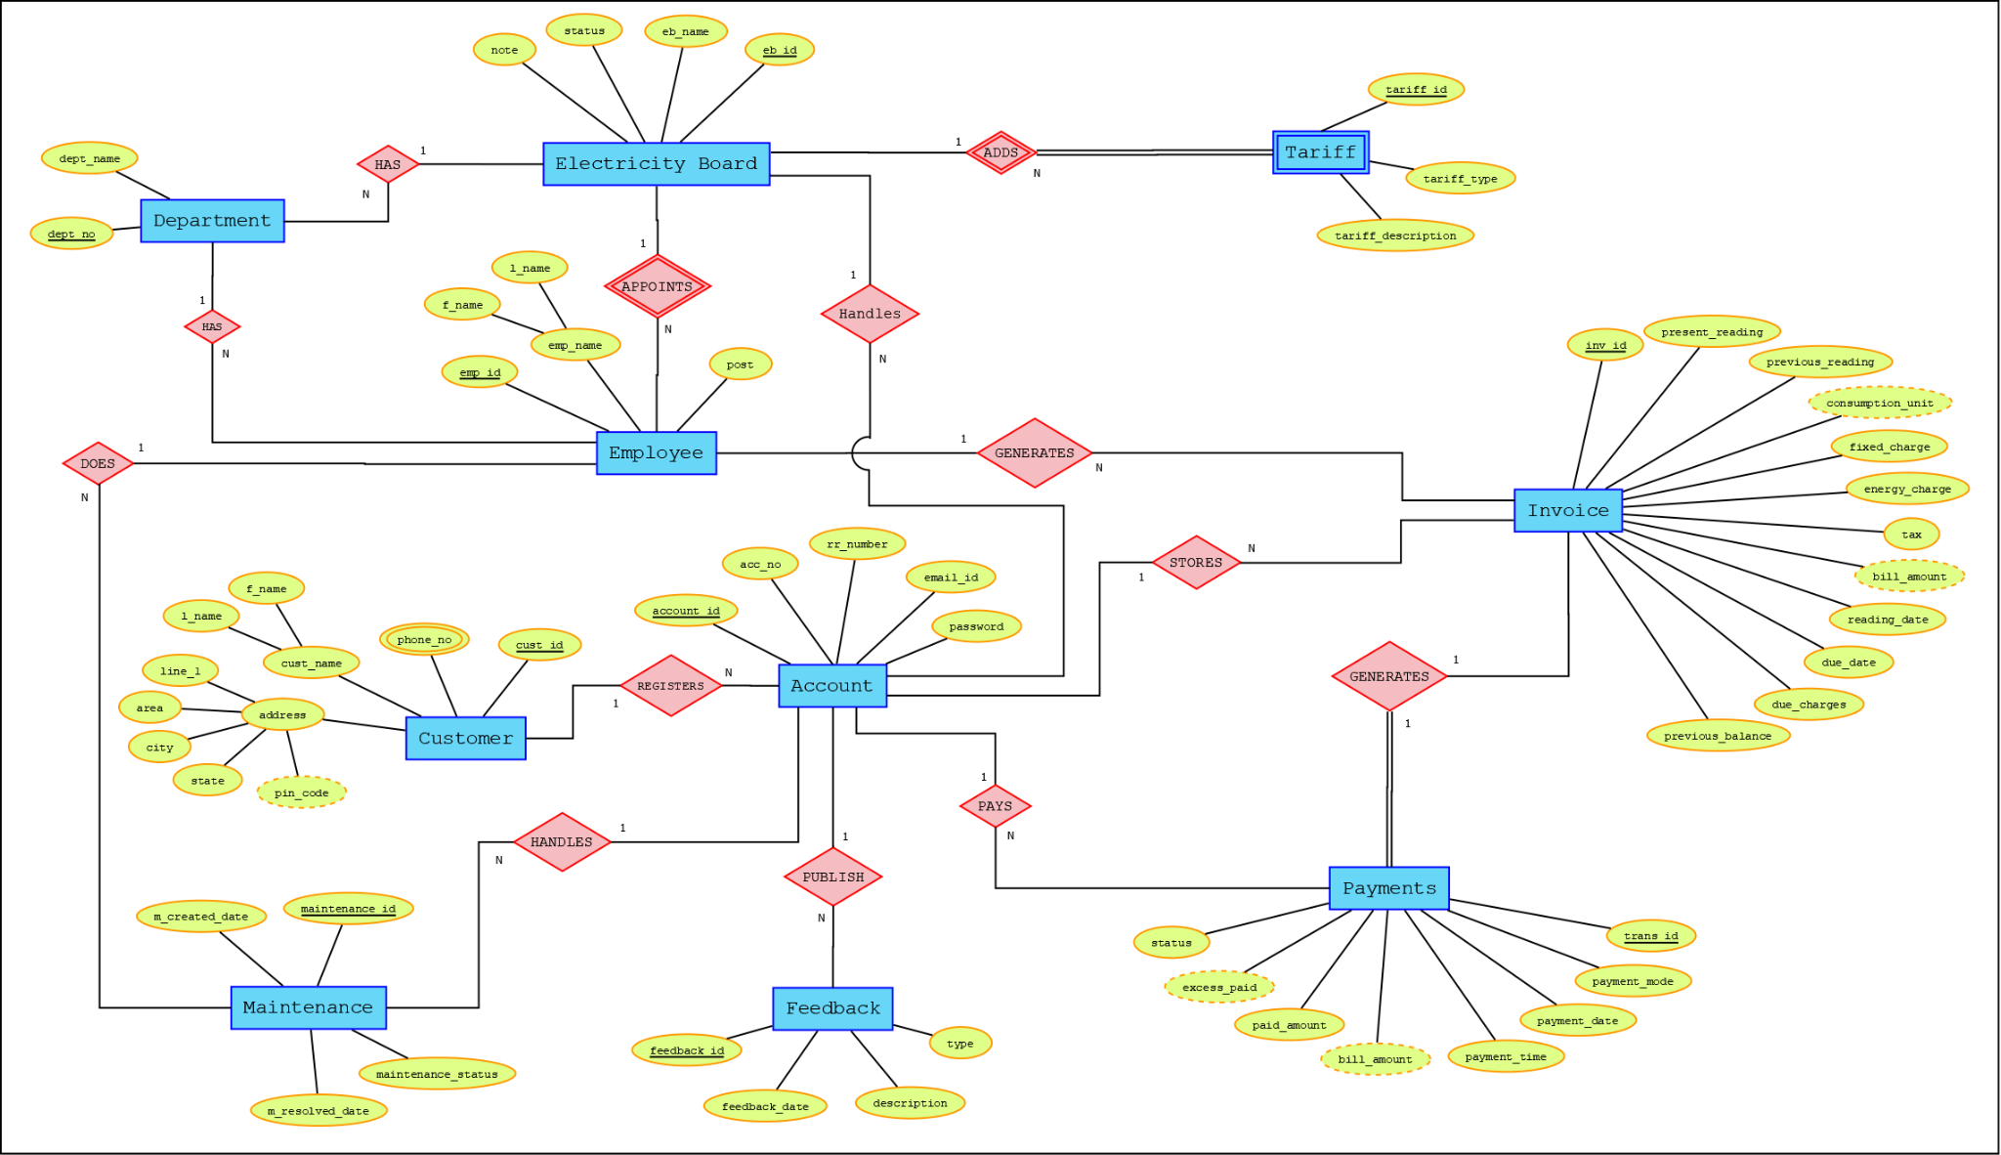
Entity Relationship Diagram

Slide 6
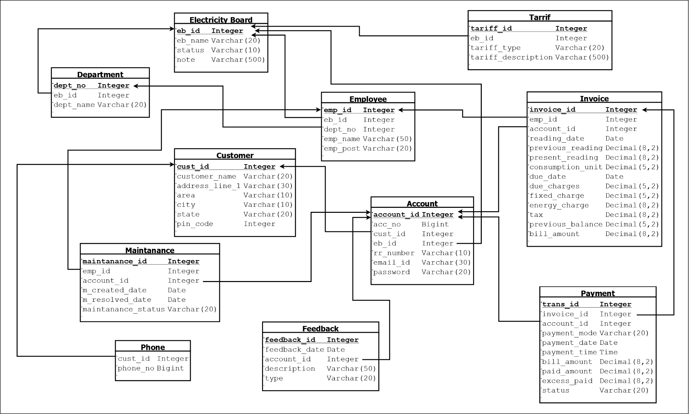
Schema Diagram

Slide 7
Customer
Phone
Account
Payment
Feedback
Maintenance
SQL DDL MODEL
Electricity_board
Invoice
Employee
Department
Tariff
DDL Script Link:
https://drive.google.com/file/d/1swup7GE53sBFNLpDYxpJCHPPJ40ginNA/view?usp=sharing

Slide 8
SQL DML MODEL
Sample SQL Queries
DML Script link:
https://drive.google.com/file/d/1NdxRVq8f_O-2Ow0beQU9kc8Ioou6RaST/view?usp=sharing
https://drive.google.com/file/d/1yke31_wKoVZQWc2Zur6TaWs2561khq6M/view?usp=sharing

Slide 9
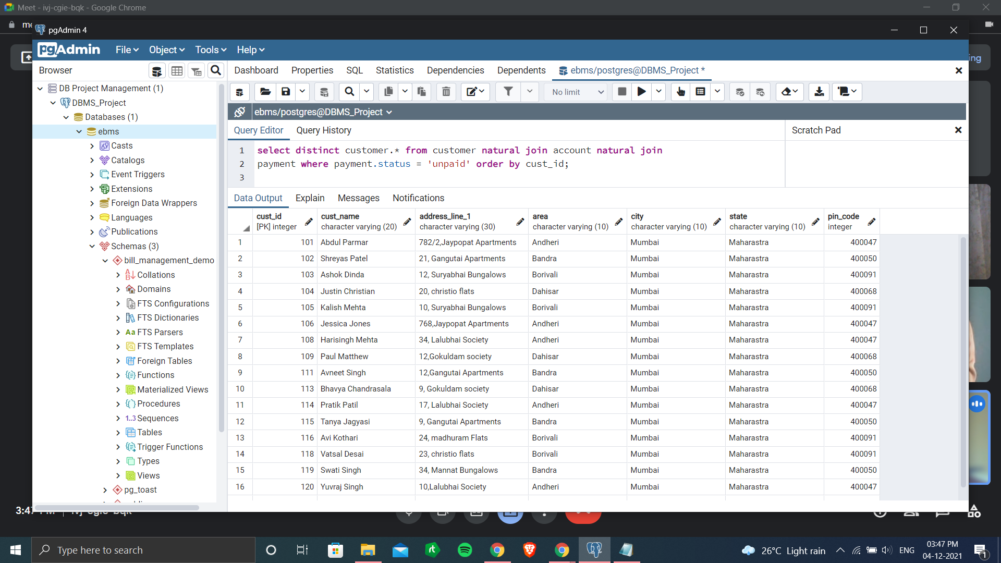

Functional Requirements(SQL Queries)
1. Retrieve all the customer whose Payment status is still pending.
Query: select distinct customer.* from customer natural join account natural join payment where
payment.status = 'unpaid' order by cust_id;
Output:-

Slide 10
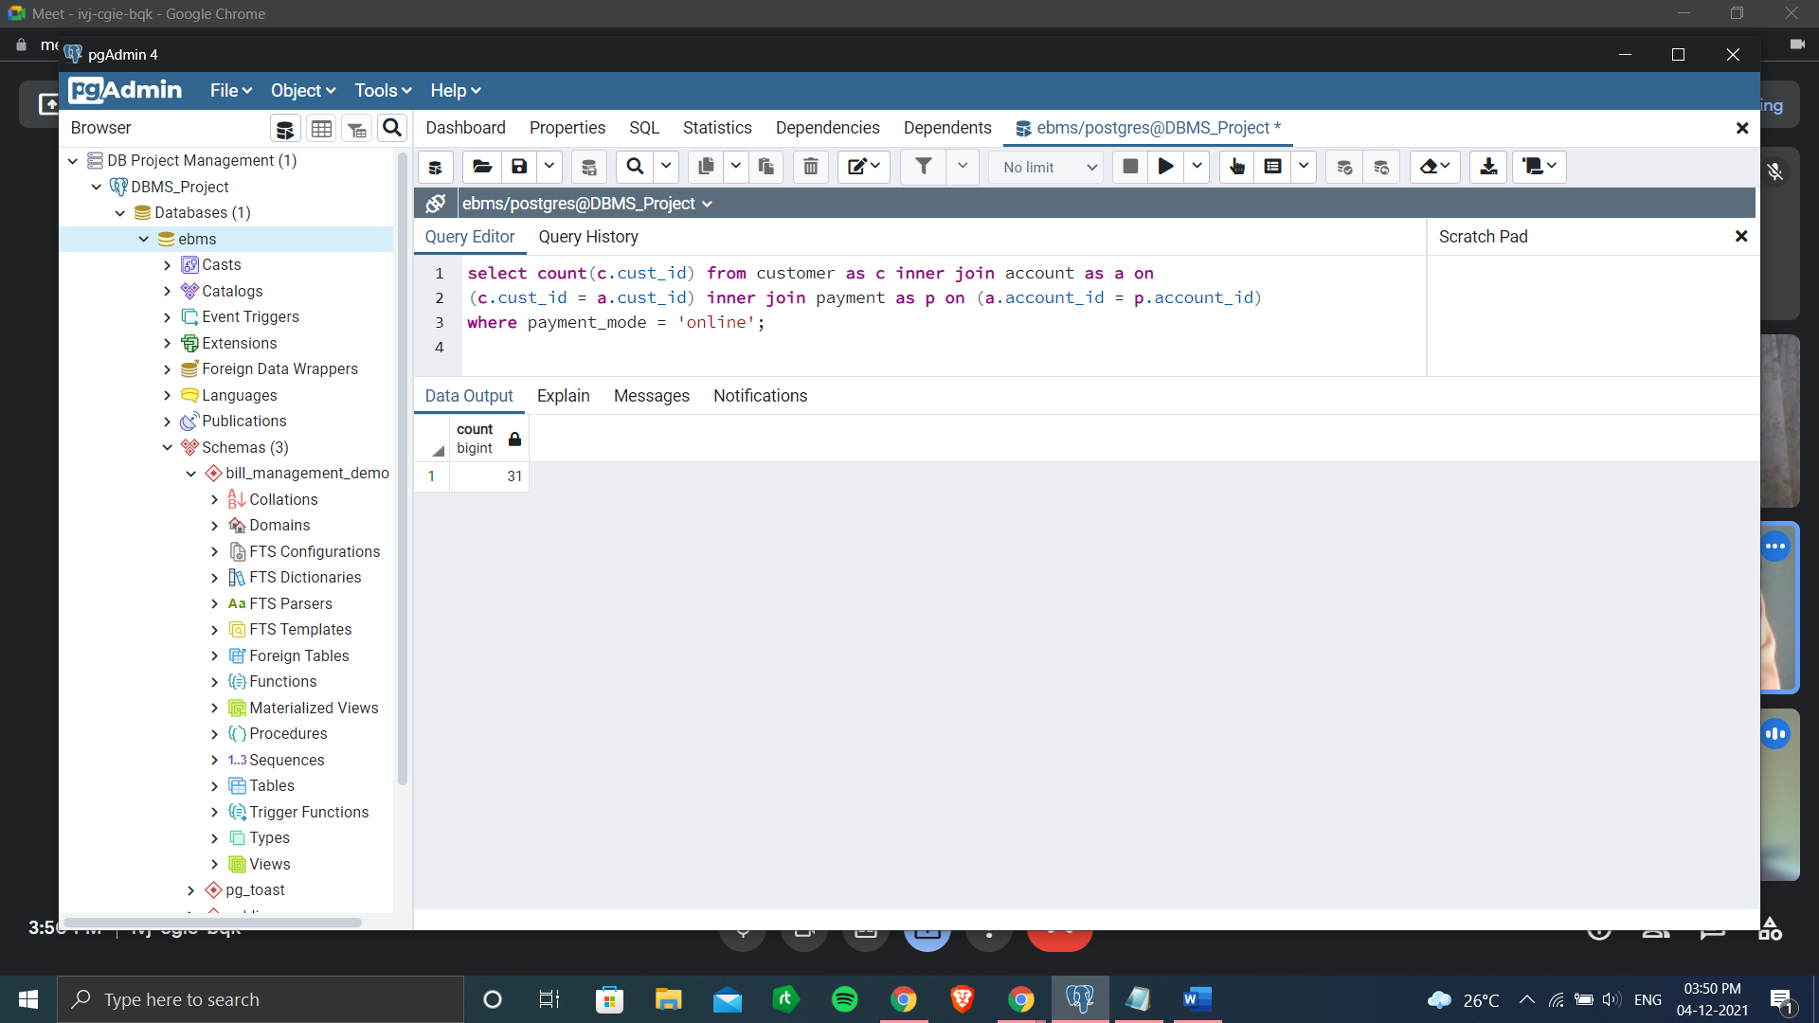

2. Find the number of customers who have paid the bill using online transaction.
Query: select count(c.cust_id) from customer as c inner join account as a on (c.cust_id = a.cust_id) inner join payment as p on (a.account_id = p.account_id) where payment_mode = 'online';
Output:-

Slide 11
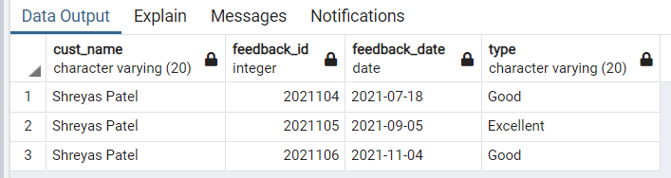
3. Show the feedback (feedback_id, feedback_date, type, cust_name) of given customer ID = 102.
Query: select c.cust_name,f.feedback_id,f.feedback_date,f.type from customer as c inner join account as a on(c.cust_id = a.cust_id) inner join feedback as f on (a.account_id = f.account_id) where c.cust_id = 102;
Output:-

Slide 12
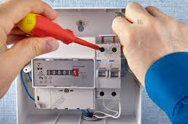
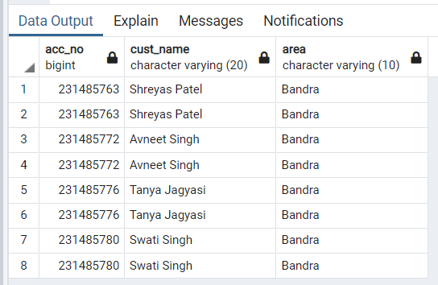
4. Get the details (acc_no, cust_name, area) of those customers whose maintenance was done by employee named ‘Popatlal Bhatia’.
Query: select a.acc_no,c.cust_name,c.area from account as a inner join customer as c on (c.cust_id = a.cust_id) inner join maintenance as m on (a.account_id = m.account_id) inner join employee as e on (e.emp_id = m.emp_id) where emp_name = 'Popatlal Bhatia';
Output:-

Slide 13
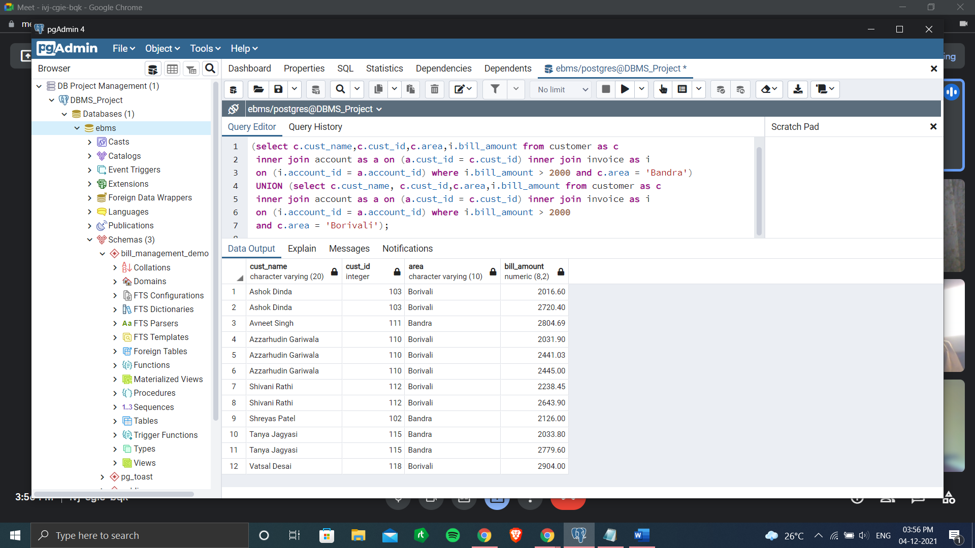
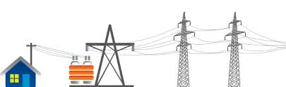
5. List all the customers (id, name, area, bill_amount) living in Bandra and borivali whose bill amount > 2000.
Query: (select c.cust_name,c.cust_id,c.area,i.bill_amount from customer as c inner join account as a on (a.cust_id = c.cust_id) inner join invoice as i on (i.account_id = a.account_id) where i.bill_amount > 2000 and c.area = 'Bandra') UNION (select c.cust_name, c.cust_id,c.area,i.bill_amount from customer as c inner join account as a on (a.cust_id = c.cust_id) inner join invoice as i on (i.account_id = a.account_id) where i.bill_amount > 2000 and c.area = 'Borivali');
Output:-

Slide 14
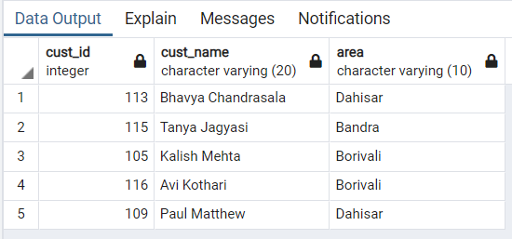
6. List the name, id and area of customer whose maintenance status are completed and feedback type is poor.
Query: (select DISTINCT c.cust_id,c.cust_name,c.area from customer as c inner join account as a on (a.cust_id = c.cust_id) inner join maintenance as m on (m.account_id = a.account_id) where m.maintenance_status = 'completed') INTERSECT (select DISTINCT c.cust_id,c.cust_name,c.area from customer as c inner join account as a on (a.cust_id = c.cust_id) inner join feedback as f on (f.account_id = a.account_id) where f.type = 'Poor')
Output:-

Slide 15

Conclusion and Learning:
We have tried to develop a system that can be a great help for the owner of any referred household i.e., the customer to receive bill from the electricity board.
And also help the Electricity board to maintain records of customer bills.
We have left all the options open so that if there is any other future requirement in the system by the admin or user for the enhancement of the system then it is possible to implement them.
Though this project we got to know different entities involved in this system and how effortlessly this system works in real life. Customer details and his bills of previous transactions are displayed in a decent manner to his/her account. In this project we came to know that how the electricity company database stores the data and how the entities are linked to each other.

Slide 16
THANK YOU

